Slide 1

STAR APP
March 14, 2023
Notes:
40 sec(Prep, Index, Project Overview)

Slide 2
Index
About Us
Project Overview
Architecture
Entity Relationship Diagram
Application Programming Interface
Process
Quality Assurance
Future Scope
Learnings
Notes:
40 sec(Prep, Index, Project Overview)

Slide 3

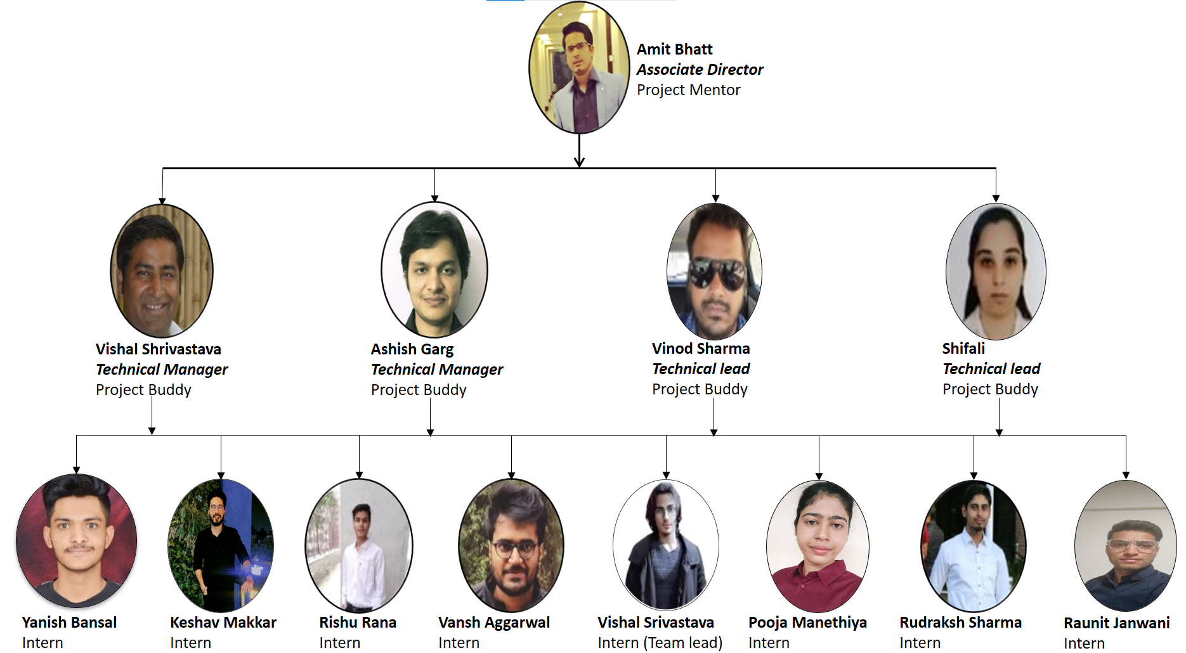
About Us
Notes:
10 sec(About US)

Slide 4


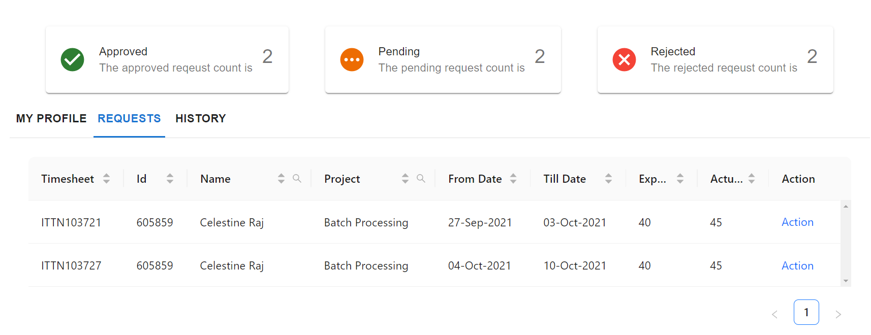
Project Overview
20
10
25
30
20
30
40
40
20
Notes:
40 sec(Prep, Index, Project Overview)

Slide 5
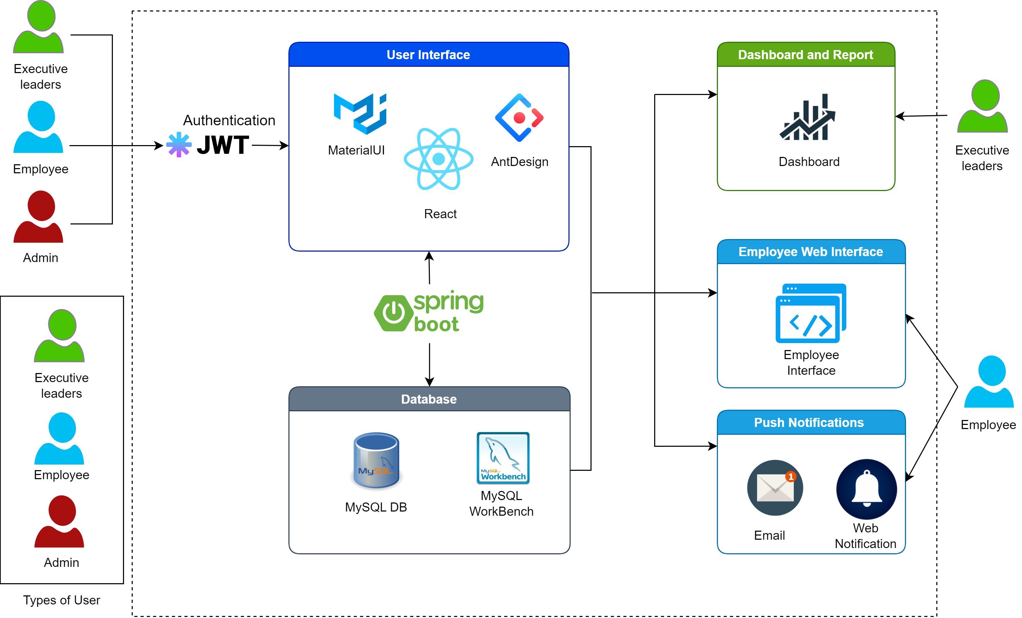



Architecture
Reusability
Achieved reusability via reactJS and Java Spring Boot
Easy To Maintain
MVC enabled architecture in
itself is highly maintainable
Component based designing provides easy maintenance
De-coupled Database
Spring Boot framework and JPA makes our WebApp DB independent
Notes:
90 sec(Arch)

Slide 6
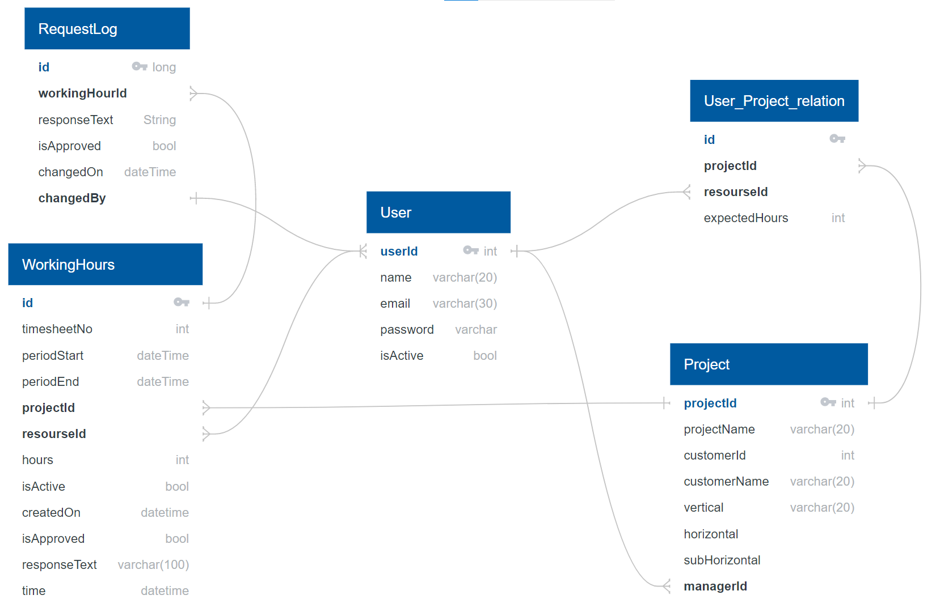
Entity Relationship Diagram(ERD)
DB Considerations
Incorporating various Business Requirements Accurately capture and track employee work hours and project activities
Agnostic RDBMS Our requirements could be best represented using a RDBMS
Normalized entities Our data is normalized to minimize redundancy and ensure data consistency
Data injection flexibility currently our data source timesheets that are provided in form of excel sheets but can be easily integrated with other data input sources.
Notes:
25 sec(ERD, API)

Slide 7
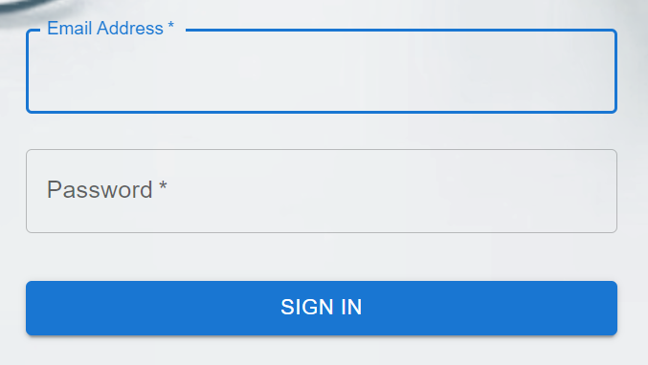
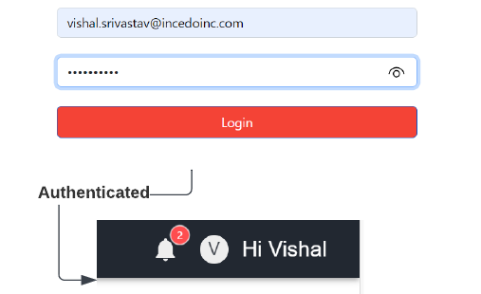
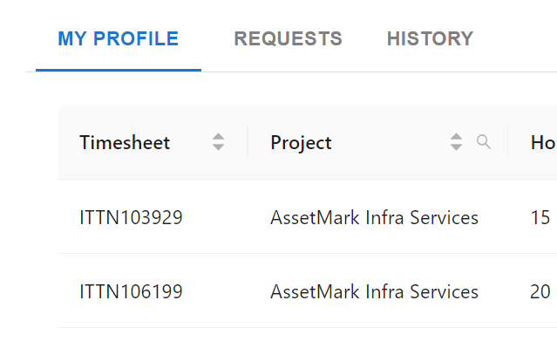
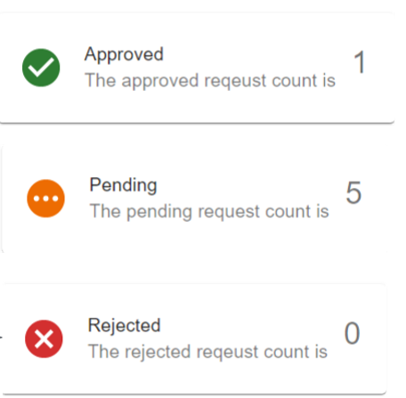
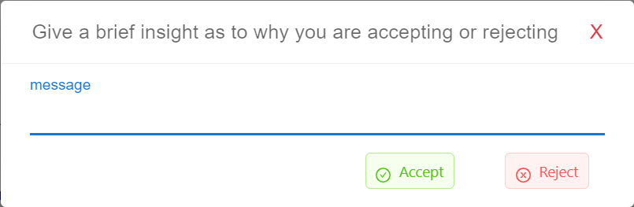
Application Programming Interface(APIs)
User management APIs
Request APIs
Authentication Generates and authorizes JWT token
User Data Fetches User Data
My Profile Get all request and its status for user
Manager Requests Get pending requests of User
Change Log Get change log of requests
User Summary APIs
Notification APIs
Status Gets the count of each type of request for resources and managers
Send Mail Notify users via mail
Push Notification Show bell notification to user on landing page
Notes:
25 sec(ERD, API)

Slide 8
Process
Weekly Sprints
Milestones
Q1-2021
Deliverables
Q4-2021
Project Kick-Off
Feasibility Study
Database Modelling
Prototype
Product backlog
Entity Relationship Diagram
Wireframes document
Open
Open
Open
Sprint 1
Discovery Phase
Design & Development Phase 1
UI design
User authentication
Backend APIs
Test plan
API testing report
Manual testing report
Open
Open
Sprint 2
Key Pointer 2
Backend and Frontend Integration
New features: Notification Request Filters Request Change Log
Sonar Cloud Integration Report
Automation testing reports
App Prototype
Open
Open
Design & Development Phase 2
Sprint 3
Minimum viable product(MVP)
Documentation
Project Presentation
Review & first release
Sprint 4
Key Pointer 3
Ceremonies
Sprint Planning | DSU | Parking Lot Meet | Sprint Demo | Sprint Retrospective
Notes:
120 sec(Process)

Slide 9





Quality Assurance
Static application security testing (SAST)
API testing
Sonar Cloud
Sonar Cloud is a cloud-based code analysis service.
Postman
Postman is an API Platform for developers to design, build, test and iterate their APIs
UI Testing
Selenium
Selenium is open-source automated testing framework
Manual
Did black box manual testing initially to
ensure all features work as expected
TestNG
TestNG is a testing framework which provides annotations and generates interactive test reports
Notes:
60 sec(QA, Manual Testing, Automation Testing)

Slide 10
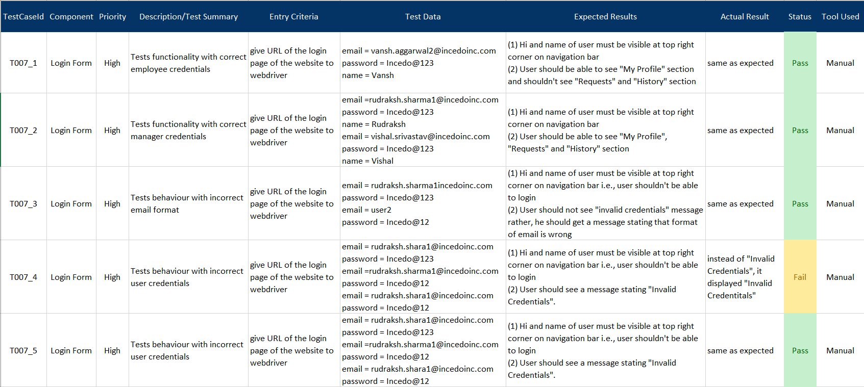
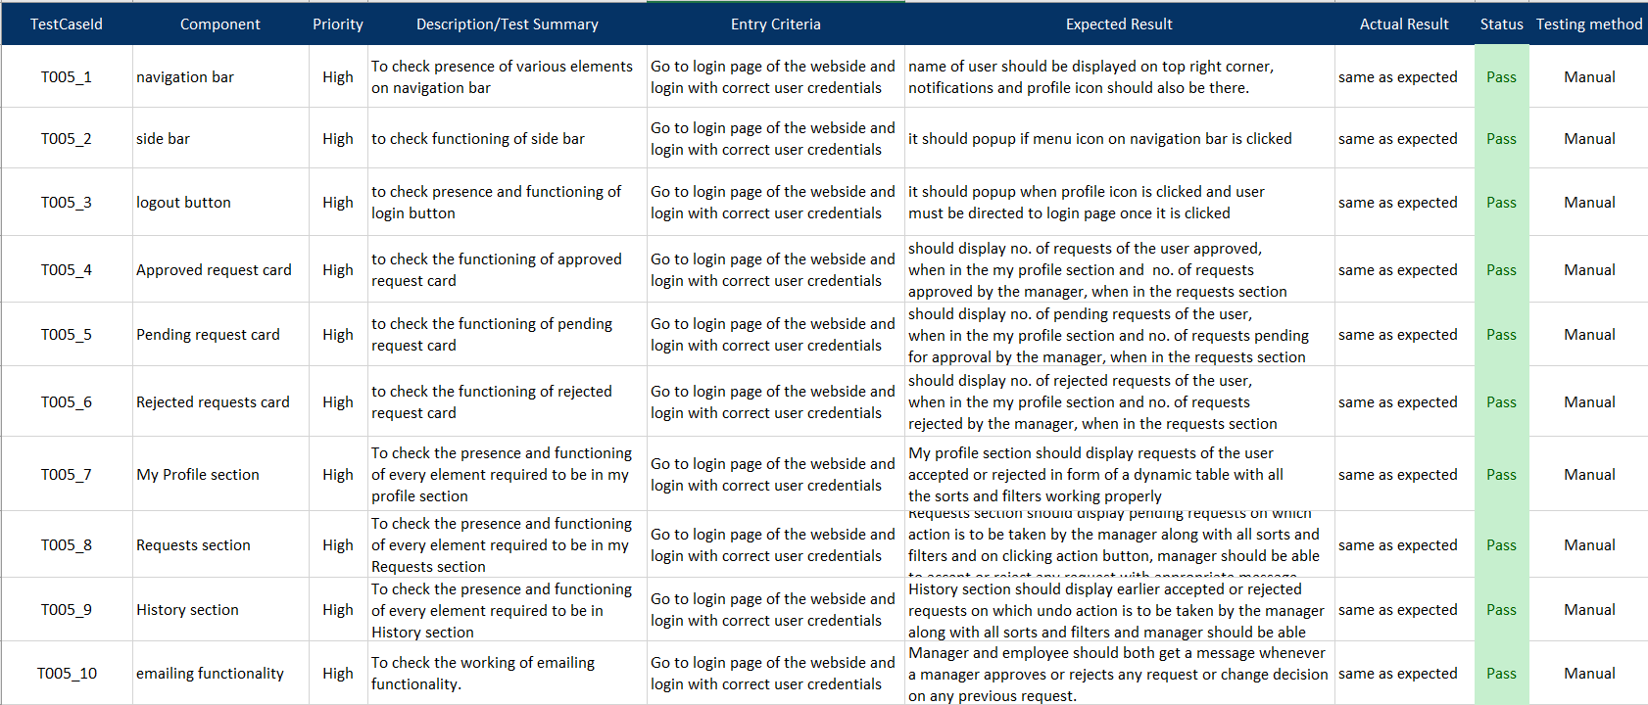

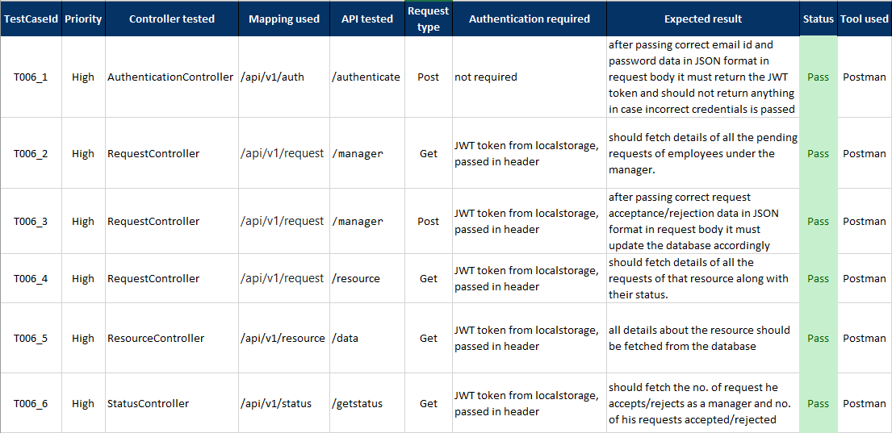
Manual Testing
User Authorization and Authentication
User Dashboard
Open
Open
Backend APIs
Summary
Testing Methods Integration and system testing(Black Box)
Effectiveness We found that are system was responding as per the requirements
Test Cases Total test cases: 28 Focus: Data input, storage and retrieval, systems ability to validate & process
Personal Takeaway Positive: It is less complex, and doesn’t require any prior set-up Negative: takes a lot of time to build test cases and perform testing
Open
Notes:
60 sec(QA, Manual Testing, Automation Testing)

Slide 11
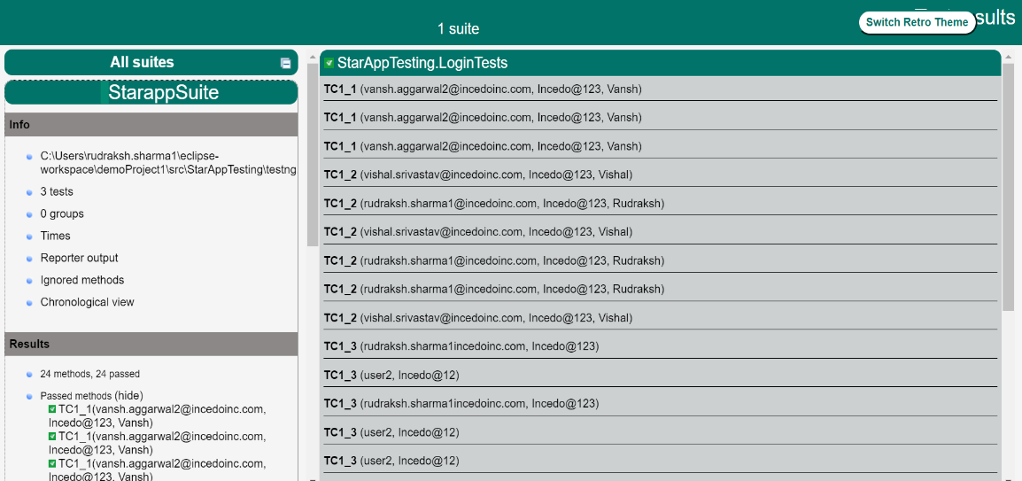
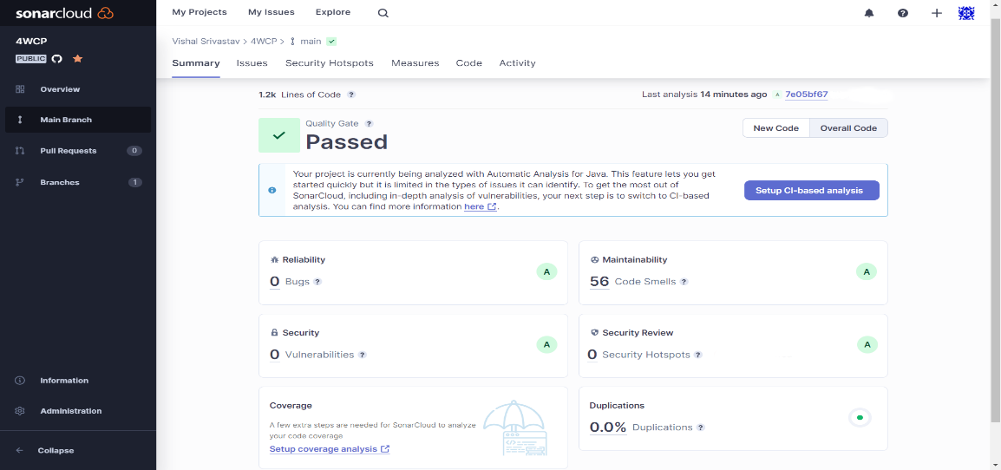
Automated Testing
TestNG Report
Selenium and TestNG summary
Browsers Tested | 3
Thread Count | 3
Test Suites | 1
Total test cases | 24
Passed test cases | 15
Failed test cases | 9
TestNG
Open
Sonar Cloud Report
Sonar Cloud Summary
Blocker issues | 1
Minor issues | 55
Critical issues | 0
Major issues | 0
Unresolved issues | 56
Resolved issues | 16
Sonar Cloud
Open
Notes:
60 sec(QA, Manual Testing, Automation Testing)

Slide 12



Future Scope
Single Sign On
Provide single sign on feature
Cloud
We could increase our scalability by moving to the cloud
Week 3 – Week 4
Week 5 – Week 7
Week 1 – Week 3
Week 4 – Week 5
MS Dynamics integration
We are looking to integrate Microsoft Dynamics to streamline data management
Analytics
Generate more in-depth reports
Provide Visualization for Managers
Notes:
20 Sec(Future scope, Learning)

Slide 13




Learnings
Kaizen
Importance
of CSI
Teamwork
Continuous learning
Collaboration
Teamwork
Ownership
Pomodoro technique
Peer learning
Resilience
Agile methodologies
Notes:
20 Sec(Future Scope & learning)

Slide 14
Question & Answers
Notes:
0 Sec

